Slide 1
Air and GHG Emissions
Data Surfers
Anuja Janet
Srinivasa Keerthy Vishnubhotla
Molly Witzenburg

Slide 2
Agenda
Introduction
Research Questions
Information sources
Data Analysis Steps
Limitations of data
Graphs
Conclusion

Slide 3
What are Greenhouse Gases?
According to the EPA they are “gases that trap heat in the atmosphere.” This trapped heat leads to increasing global temperatures which cause:
Less stable weather patterns (more floods, droughts, or intense rain, as well as more frequent and severe heat waves.)
Animal and Plant species extinction
Ocean Warming and Acidification
Greenhouse gases are primarily caused by burning fossil fuels, solid waste, trees, and wood, and also the result of industrial practices.

Slide 4
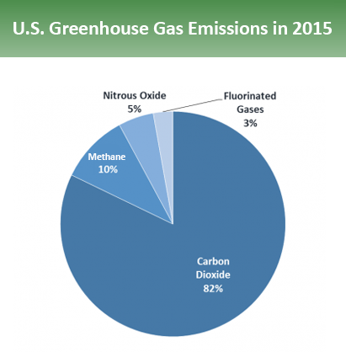
Three types of greenhouse gases we will address:
Carbon Dioxide (CO2)
Nitrous Oxide (NOX)
Sulfur Oxides (SOX)
With NO greenhouse gases at all in its atmosphere, scientists estimate that Earth’s average atmospheric temperature would be about -18 deg C.

Slide 5
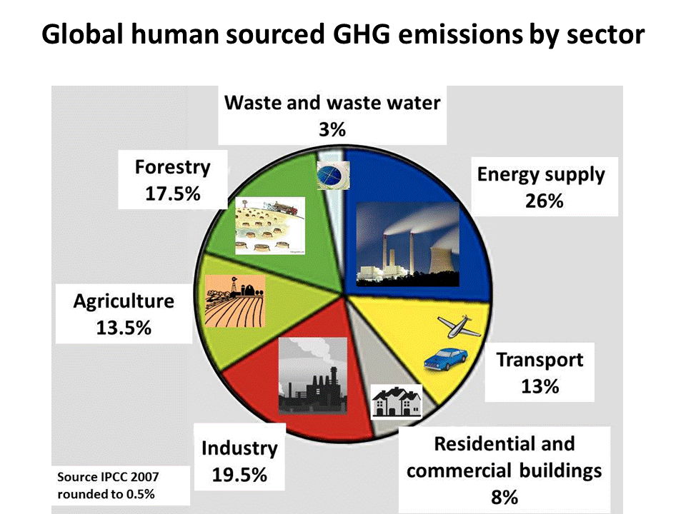
Sources of Greenhouse Gas Emissions
Electricity Production
Transportation
Industry
Commercial and Resident
Agriculture
Land Use and Forestry

Slide 6
Data Source
OECD - Organization for Economic Co-operation and Development.
The dataset consists of columns such as location, indicator, subject, measure, frequency, time, value, flag_codes.
The mission of OECD is to promote policies that will improve the economic and social well-being of people around the world.
The OECD provides a forum in which governments can work together to share experiences and seek solutions to common problems.

Slide 7
First Research Question:
Which countries and regions contribute the most CO2 emissions, both on a total volume basis and from a per capita perspective? Do the top offenders have similar patterns of increasing and decreasing emissions?
To answer this question, we looked at the top five CO2 producers by volume since 1971, at approximately 5 year increments. There were seven countries that were in these top 5 for the years analyzed.
We used population data from the World Bank and calculated a per capita consumption amount for each data point.
We then graphed total and per capita emissions for each of the top 7 countries.

Slide 8
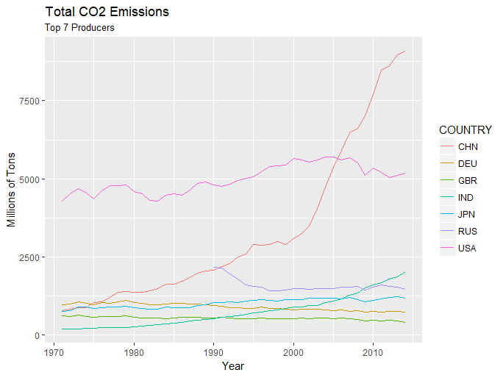
Total Emissions
Total emissions changed slowly for most leading countries.
US was consistently highest, showing greater rate of increase through the 90’s than other leaders.
China’s total emissions have increased steadily and particularly steeply since 2000. But are expected to level off in the next decade.
India shows consistently growing emissions.
Russian data is unavailable prior to 1990 and the disbanding of the Soviet Union.

Slide 9
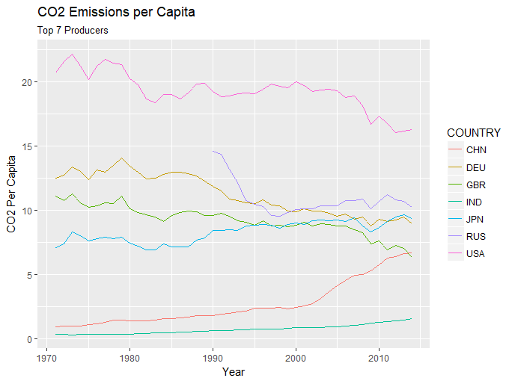
Per Capita Emissions
Most countries show decreasing trend in per capita emissions over time.
China shows a steep rise in per captia emissions, although still much lower than US.
India showing a slow increase in per capita emissions, but much lower than other top producing countries..

Slide 10
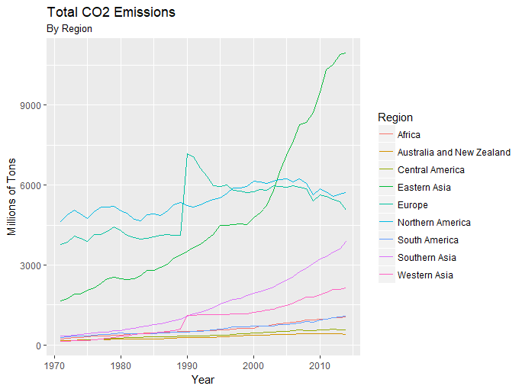
Regional Emissions
Regions Dominated by US and China much higher emissions than other regions of the world.
Europe leaps in 1990 with the addition of Russia. Western Asia adds other former Soviet states at the same time.
Europe, North America, Australia, and Central America show recent decreases or leveling of total emissions.
Asian regions show varying rates of increasing emissions.

Slide 11
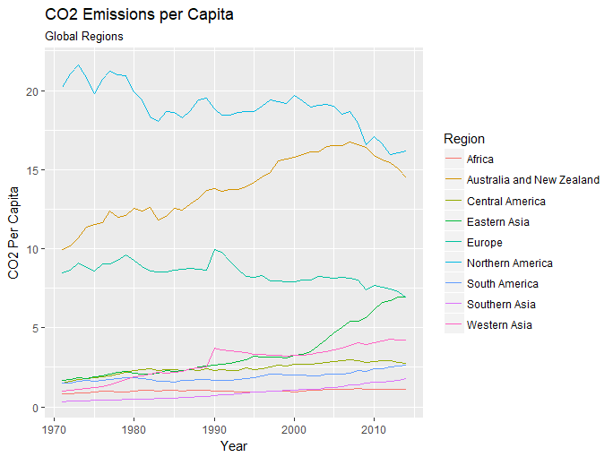
Regional Emissions Per Capita
1990 Again sees a bump in European consumption from the addition of Russia.
Western Asia sees the same bump from the addition of other former Soviet States (Azerbaijan, Georgia, Kazakhstan, Kyrgyzstan, Uzbekistan, Turkmenistan)

Slide 12
Second Research Question
According to the values in the dataset, are urbanization, population reasons for amount of CO2 emission? Are urbanization rates correlated to carbon dioxide emissions?
We answered this question by analyzing the correlation between Urbanization and CO2 emissions.
Positively Correlated.
Top 5 largest CO2 emissions - China, USA, Russia, India, Japan
Top 5 urbanized countries - Hong Kong, Singapore, kuwait, Belgium, Qatar
Top 10 urbanized countries with population > 100 million - Japan, Brazil, USA, Mexico, Russia, China, Philippines, Pakistan, Bangladesh, India.

Slide 13
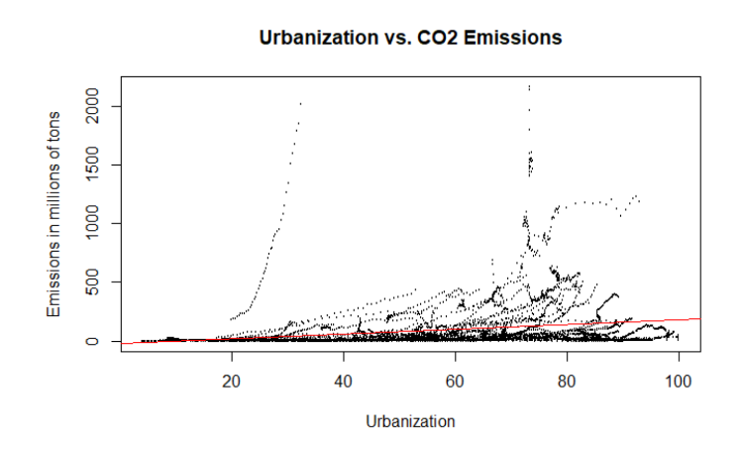
Correlation between Co2 Emissions and Urbanization

Slide 14
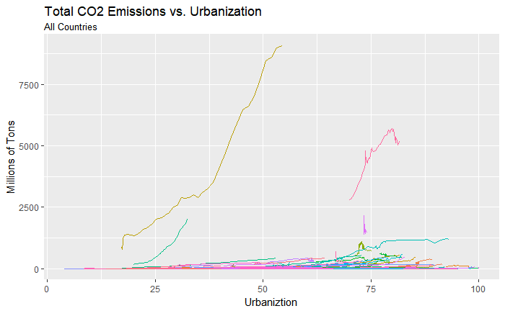
Country wise CO2 emissions vs Urbanization
Most of the countries show steady
Increase in CO2 emissions as
Urbanization rate increases.
Except China, USA all have CO2 emissions
less than 2500 million tonnes.
China has Urbanization percentage
less than 54%
We can see a positive correlation
between Urbanization and CO2 emissions

Slide 15
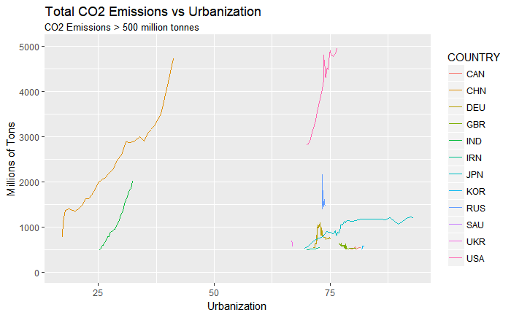
Countries with largest CO2 Emissions
Surprisingly, countries such as Russia,
DEU(Germany) show steady decrease in
emissions after a point of time.
China, India, USA show steady increase.
Out of these 13 countries, 11 countries
are highly urbanized(>50%).
So we can state that urbanization can also
be considered as one of the factors for
Increase in CO2 gas emissions.

Slide 16
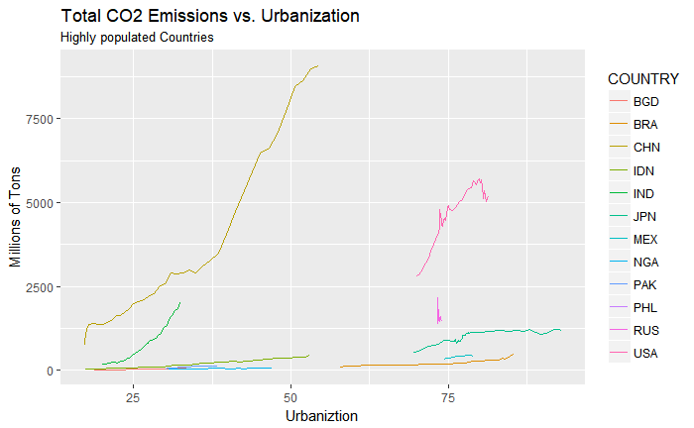
Highly populated Countries
Population greater than 100 million.
They vary differently irrespective of
their urbanization level.
Highly urbanized countries (>50%) such as
Korea, Russia, Germany have a steady
decrease in CO2 emissions when compared
less urbanized countries (<50%) such as
China and India.

Slide 17
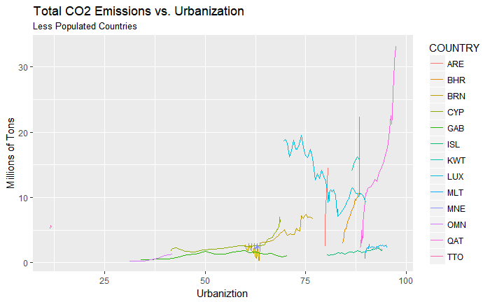
Less Populated Countries
Population less than 10 million.
Mostly Urbanized.
CO2 emissions less than 40
million tonnes.
Iceland has world’s first “negative
Emissions plant” where CO2 is converted
into stone.
“Capture-Compress-Buried “

Slide 18
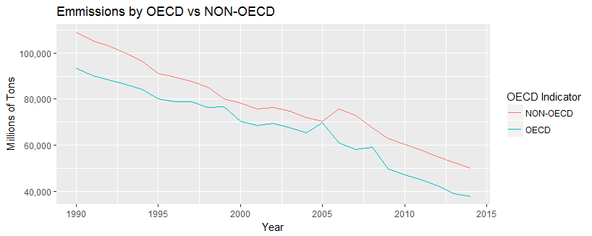
OECD vs NON-OECD countries (NOX,SOX)
Nox, Sox gas emissions started decreasing.
OECD countries produces more emissions than non-OECD countries.
China is a part of non-OECD countries.

Slide 19
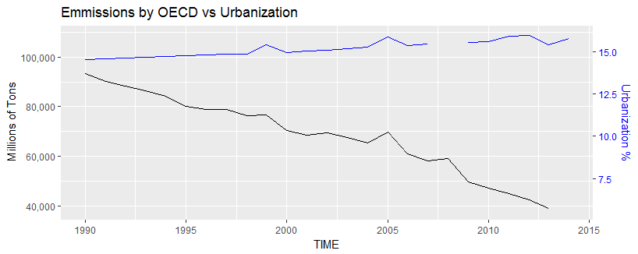
OECD VS Urbanization (NOX,SOX)
Urbanization increased but not with great velocity.
If urbanization has increased more, emissions might not have decreased with this slope.

Slide 20
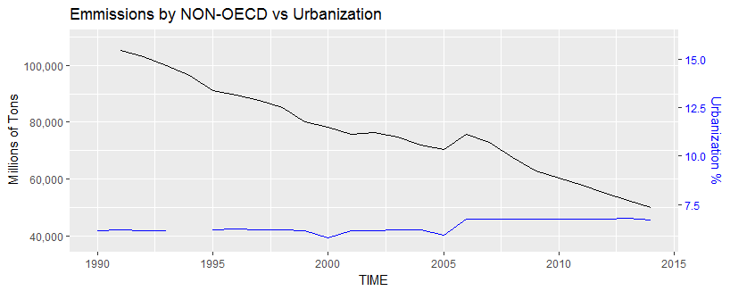
Non-OECD VS Urbanization (NOX,SOX)
Though the urbanization is low, the emissions are high because of china.
If urbanization has increased more, emissions might not have decreased with this slope.

Slide 21
Limitations
Our analysis was made for the time period 1961-2015.
We did not consider records which had missing values as assuming the value or replacing the values with mean did not seem to be a good option.
Our analysis based on Urbanization and population did not include Taiwan.

Slide 22
Conclusion:
Everyone needs to care about greenhouse gas emissions, for we are all affected by the changing climate.
Studies have shown that the greatest effects of the changing climate are occurring in the most vulnerable populations who are actually contributing the least to the problem.
It is a moral and ethical imperative for all who are in a position to affect change to support local, regional, national, and international policies that will reduce emissions, restore wetlands, and end deforestation on a global scale. Evidence exists that when global forces come together, emissions are reduced.

Slide 23
Bibliography
“Overview of Greenhouse Gases.” Epa.gov. US Environmental Protection Agency. URL: https://www.epa.gov/ghgemissions/overview-greenhouse-gases. Accessed: 11/30/2017
“Sulfur Dioxide Basics.” Epa.gov. US Environmental Protection Agency. URL: https://www.epa.gov/so2-pollution/sulfur-dioxide-basics#what is so2. Accessed: 11/30/2017
“Climate Change: Basic Information.” Epa.gov. Formerly maintained by the US Environmental Protection Agency. URL: https://19january2017snapshot.epa.gov/climatechange/climate-change-basic-information_.html#difference. Accessed: 11/30/2017
“Our Mission.” OECD.org. Organisation for Economic Co-operation and Development. URL: http://www.oecd.org/about/. Accessed: 11/30/2017
“After a Brief Rise, Carbon Emissions are Back on the Rise.” Mary Beth Griggs. Popular Science. November 13, 2017. URL: https://www.popsci.com/carbon-emissions-are-up-again-this-year. Accessed: 11/26/2017.
“China Seen Reaching Peak Carbon Emissions by 2030: Study.” Bloomberg News. November 21, 2017. URL: https://www.bloomberg.com/news/articles/2017-11-22/china-seen-reaching-peak-carbon-emissions-by-2030-survey-finds. Accessed: 11/26/2017
“World's First.” Rathi, Akshat. Quartz, 12 Oct. 2017, URL: https://qz.com/1100221/the-worlds-first-negative-emissions-plant-has-opened-in-iceland-turning-carbon-dioxide-into-stone/. Accessed: 12/3/2017
“Climate Change.” APES Air Pollution Review - Home, noair-rors.weebly.com/climate-change.html
http://noair-rors.weebly.com/climate-change.html

Slide 24
Bibliography Continued:
Data Set: https://data.oecd.org/air/air-and-ghg-emissions.htm
Also used: https://data.worldbank.org/indicator/SP.URB.TOTL.IN.ZS
https://data.worldbank.org/indicator/SP.POP.TOTL?page=2

